Slide 1
Alcohol, you, & others
Alcohol and violence go together.
Alcohol makes it more likely to be a victim of violence because you can’t protect yourself.
Causes Fetal alcohol syndrome (FAS) (mothers blood passes to fetus)-small size at birth, brain damage, mental retardation, severe emotional problems, learning disabilities, social interaction.

Slide 2
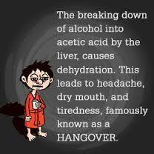
Factors that determine alcohol’s effects on the body:
1. amount of alcohol consumed
2. weight
3. amount of food consumed
4. drinking habits (tolerance)
5. Gender
6. Genetic factors

Slide 3
Drinking and driving
A single drink can effect your reaction time.
DUI (Driving Under the Influence)-can lose drivers license, do jail time, if causes death can get vehicular man slaughter.
To protect yourself or others
1. Avoid situations where alcohol is present.
2. Arrange a ride beforehand.
3. Don’t get in a car or let a friend drive drunk.
4. Give your keys to someone before you drink.
5. Get a Taxi.
http://www.youtube.com/watch?v=eNInyKmcsWw
Http://www.youtube.com/watch?v=oNrh0uILyUQ

Slide 4
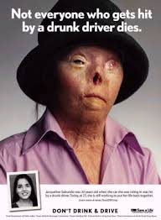
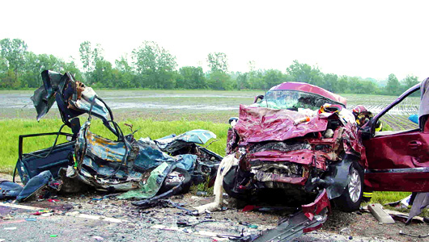

Slide 5
Binge Drinking
Drinking a lot of alcohol in one sitting to get drunk.
Men 5 drinks
Women 4 drinks.

