Slide 1
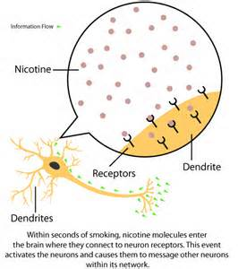
Forming a Tobacco Addiction
480 x 540 · 24 kB · png·The Short and Long Term Effects of Nicotine on the Brain.
Addiction=a condition in which a person can no longer control his or her need or desire for a drug.
One way the brain responds to nicotine is by increasing the number of nicotine receptors in the brain. Therefore, tobacco users need more nicotine to fill these receptors.

Slide 2
Terms
tolerance-needing more of the drug to get the same effects as you did the first time.
Physical Dependence-Your body needs the drug to feel normal.
Withdrawal-symptoms that occur when a drug is stopped being used. I.e.) headaches, irritability, pain.

Slide 3
Why People Use Tobacco
*Peer Pressure
*It’s Cool
*Fun
*Feel Grown up
*Curiosity
*Tempted by Family, Celebrities, and Media

Slide 4
Reasons To Be Tobacco Free
*Nicotine is VERY addictive.
*Tobacco is deadly.
*You will smell bad, teeth will be yellow.
*It is expensive.
Average=$5.95 per pack
40% tax in Idaho
Do the math…What can you buy with the money?

Slide 5
Quitting
70% smokers want to quit.
4-5% are successful.
100 smokers, 70 want to quit, 1 of the 70 will be able to quit.

Slide 6
Help to Quit
Support group and counseling, hypnosis.
NRT= (Nicotine Replacement Therapy)
Non-prescription-Gum, patches, lozenges, vapes
Prescription-inhalers and nicotine nasal sprays.
Prescription medications block nicotine’s actions in the brain.
exercise

